Slide 1
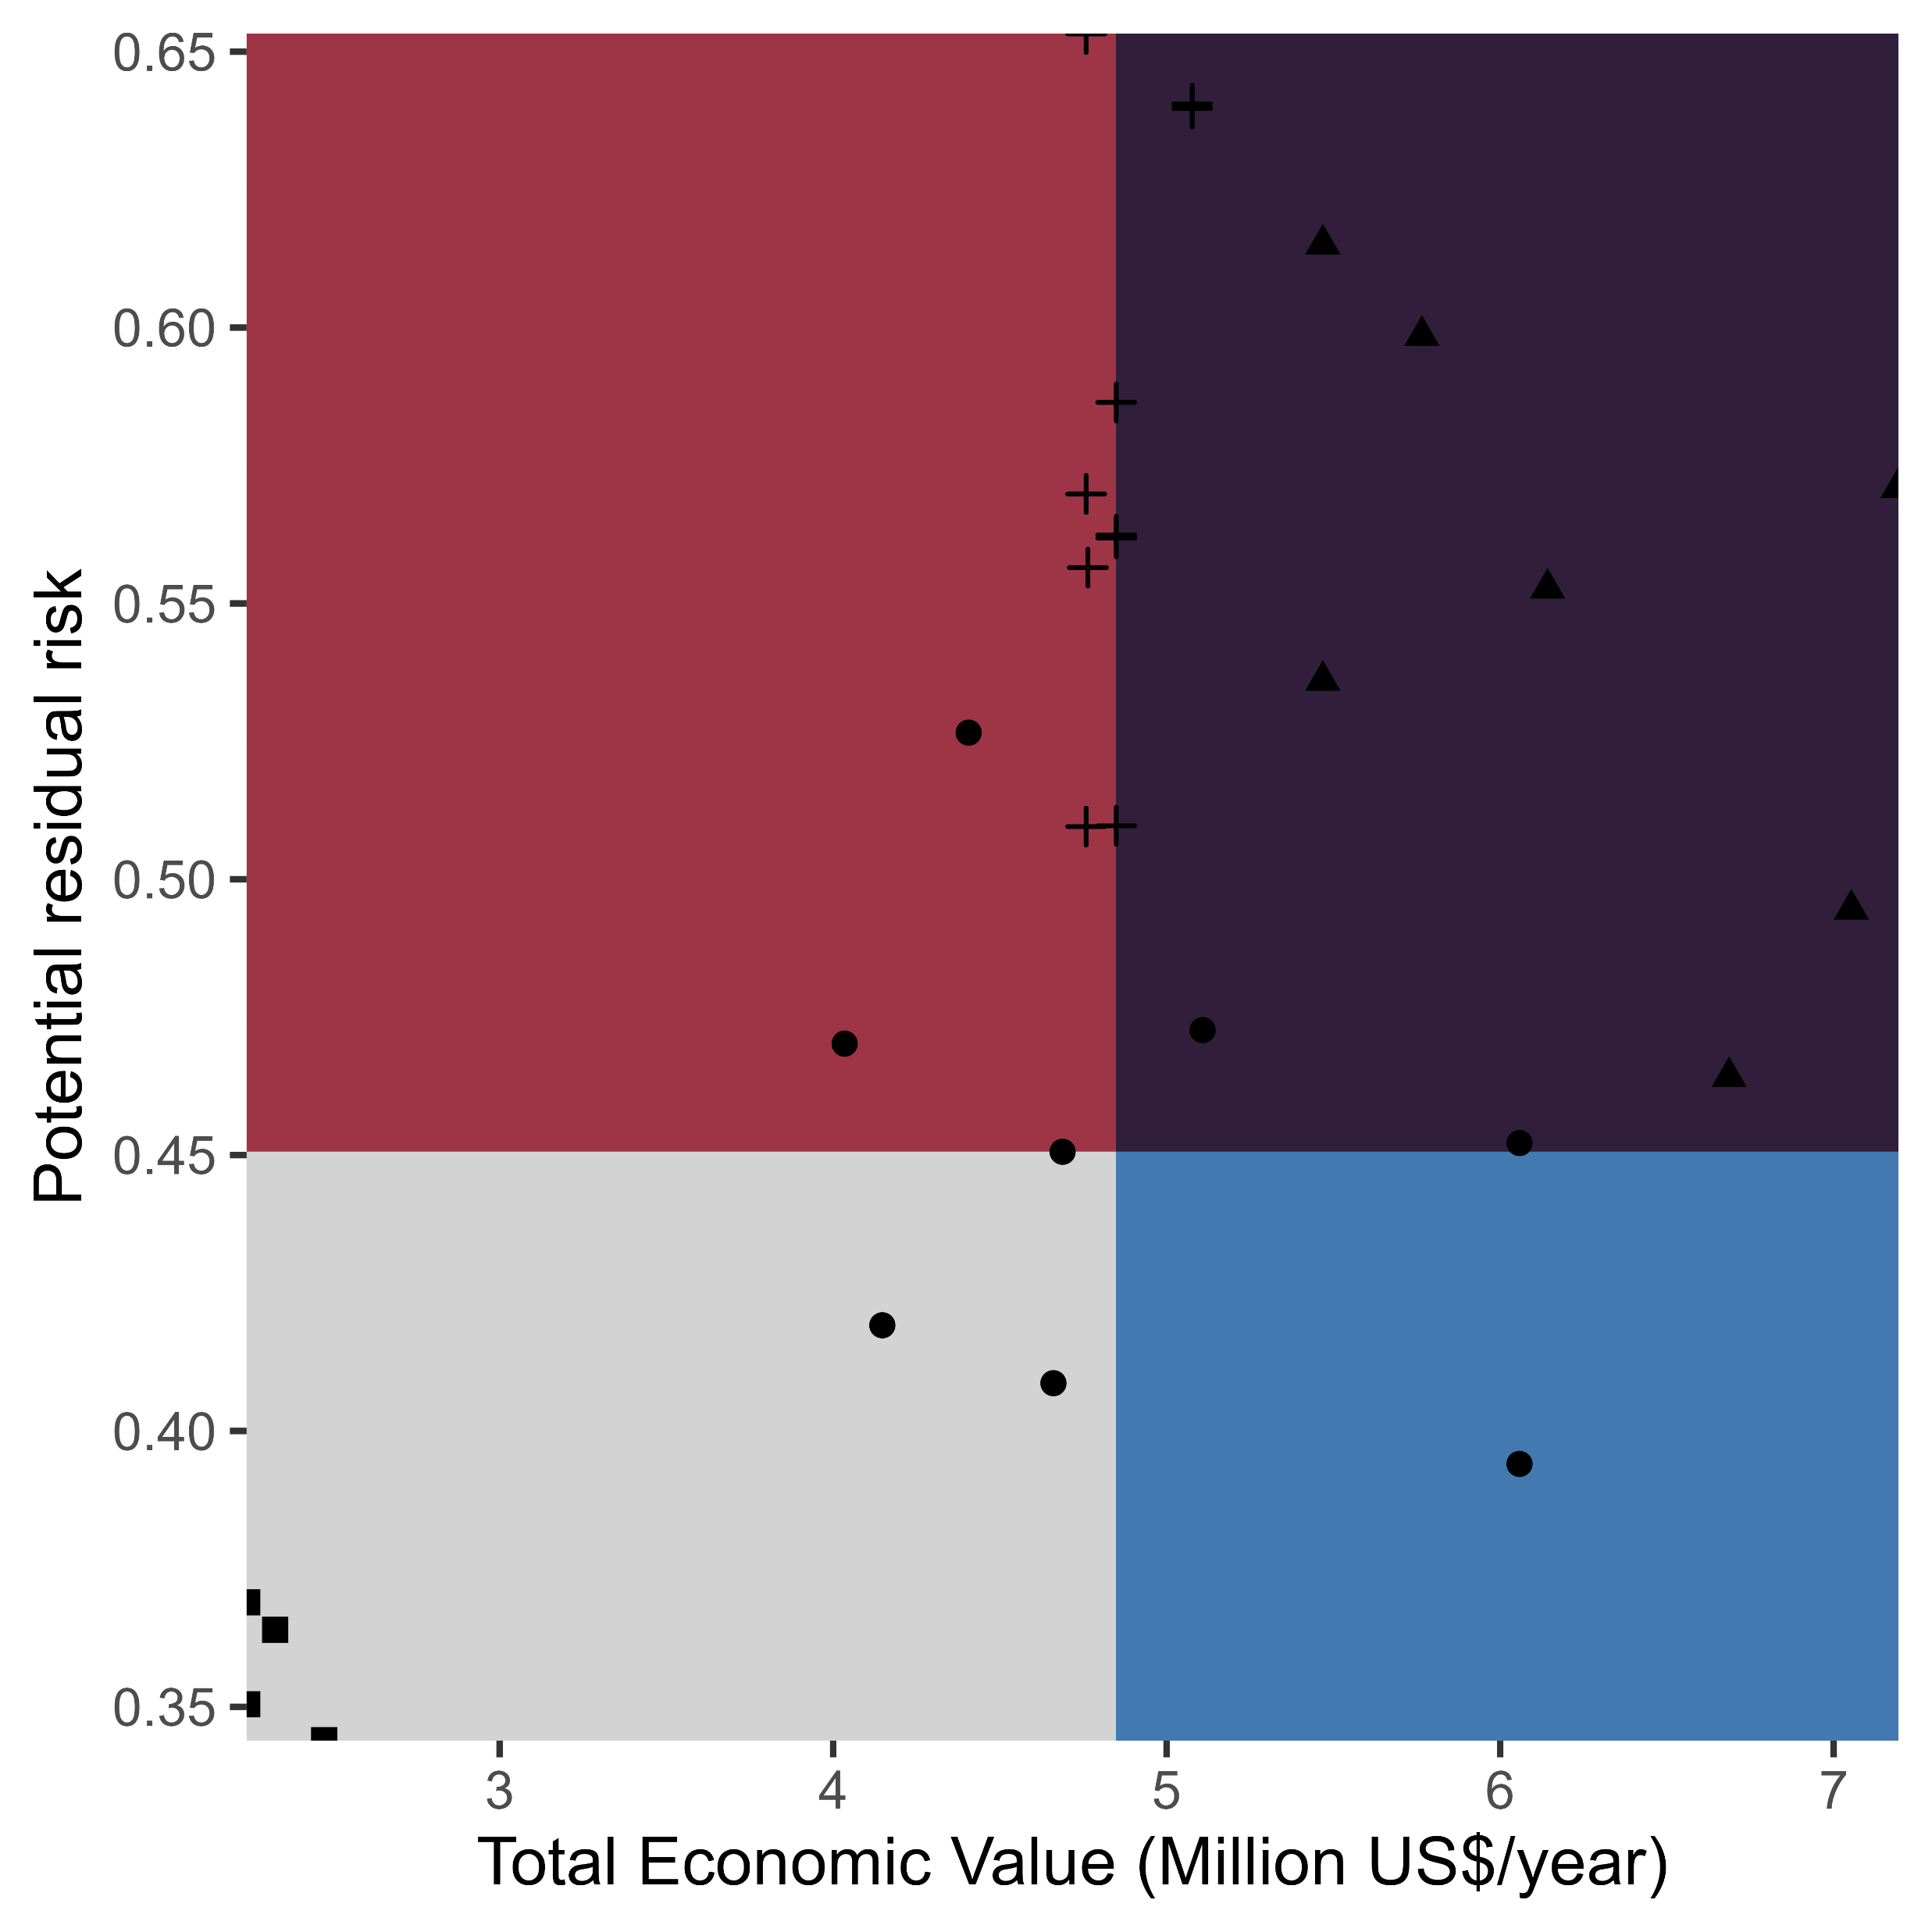
BOX 1
Scenarios for mediating residual risk for coastal villages
These four scenarios ……
B: Curative Loss and Damage (CLD)
C: Palliative Loss and Damage (PLD)
A: Baseline Residual Risk (BRR)
D: Climate Change Adaption (CCA)

